Slide 1
SAP BTP CLD500 Training
Day 2
Anubhav Oberoy
www.AnubhavTrainings.com
Follow excellence with sheer passion

Slide 2

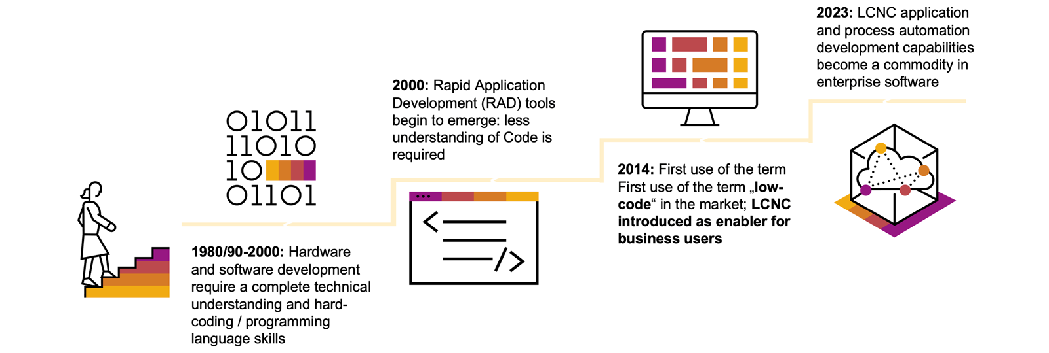
Low-Code / No-Code Technology
The evolution of coding can be traced back to the 1950s, when the first programming languages were created to communicate instructions to a computer. By the 1980s, software development was becoming an important business competency following rigorous knowledge and practices until the end of the century.
Now, after twenty more years of evolution, the emergence of visual programming tools, application programming interfaces with integrations, and the platform economy have democratized development.
www.anubhavtrainings.com

Slide 3
Low Code v/s No Code
Low-code and no-code (LCNC) refer to a new style of visual programming that makes it possible to develop applications without the use of coding languages, which greatly reduces the barrier of entry for anyone looking to take up application development. To differentiate between the two aspects:
Low-code uses both a traditional programming language-based environment combined with no-code platforms and is used by developers with at least basic technical knowledge.
No-code is simpler, and it fully replaces the traditional programming language-based tooling with a suite of visual development tools (ex. drag-and-drop components) and can be used by technical and non-technical people alike, such as citizen developers.
On the other end of the spectrum, you have the most complex work, the traditional software development where high-level programming knowledge and professional development experience is required to build applications and automations that solve nuanced problems.
www.anubhavtrainings.com

Slide 4
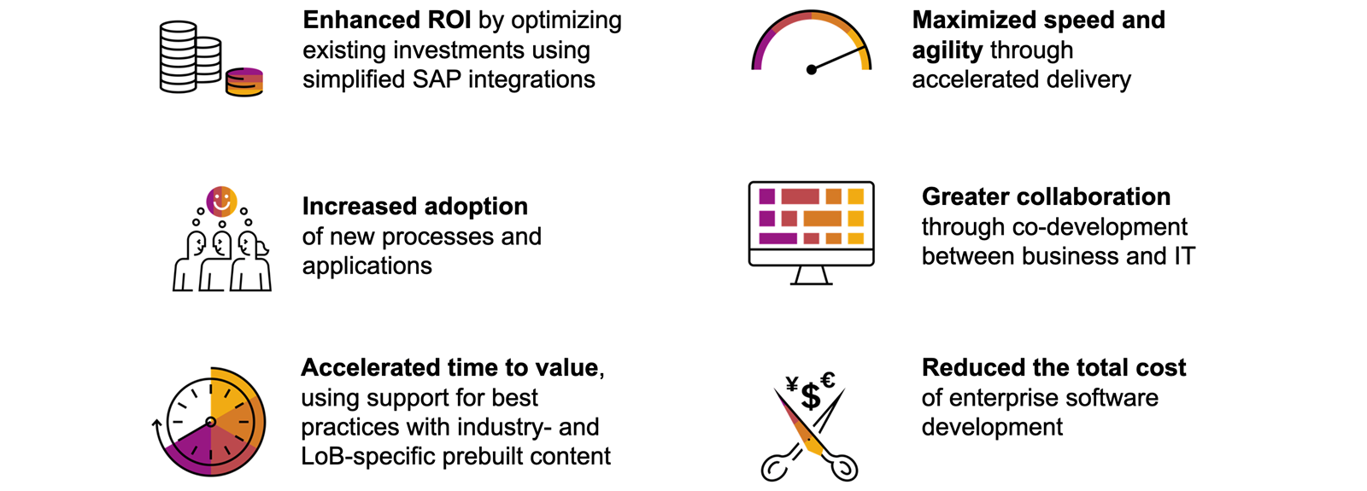
Advantages of Low-Code / No-Code Platforms
www.anubhavtrainings.com

Slide 5
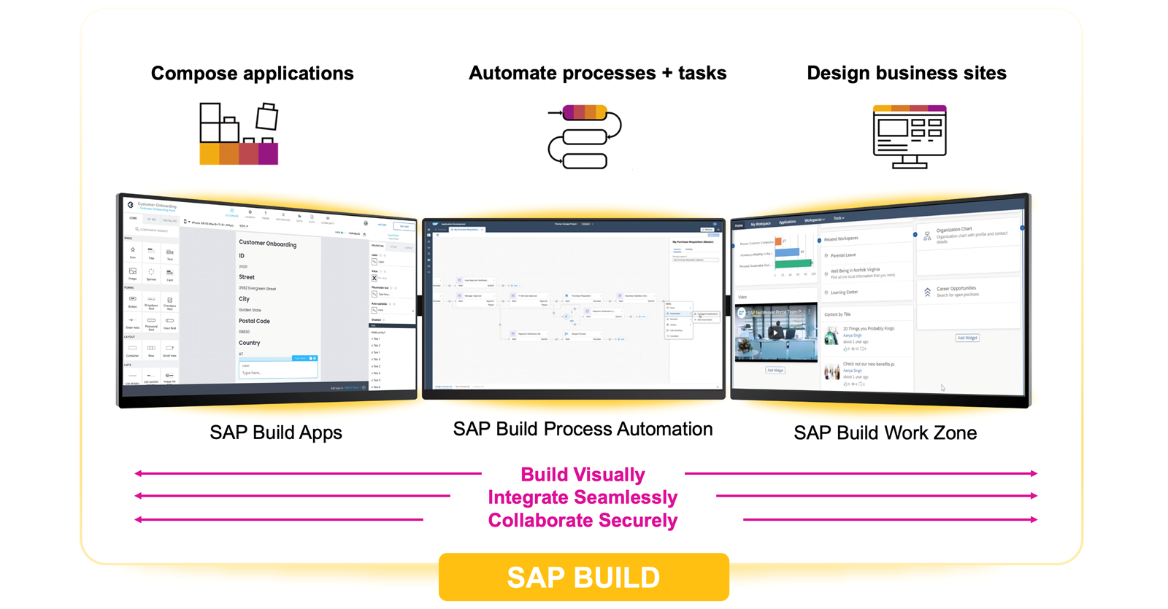
SAP Build for Citizen Developers
www.anubhavtrainings.com

Slide 6
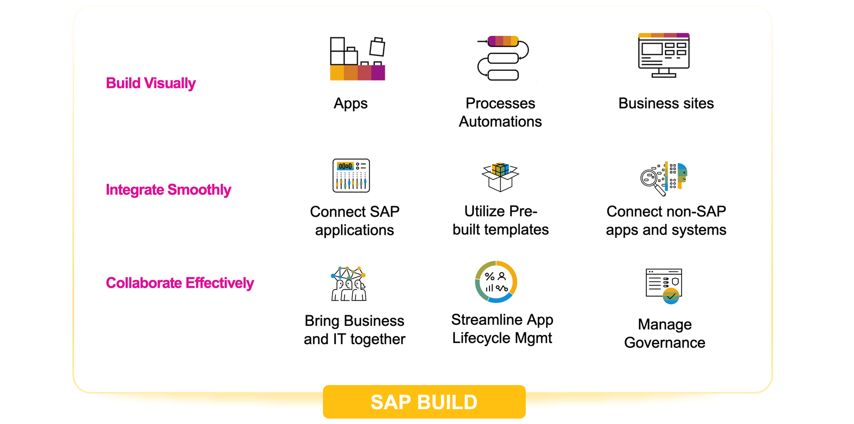
Key Advantages
www.anubhavtrainings.com

Slide 7
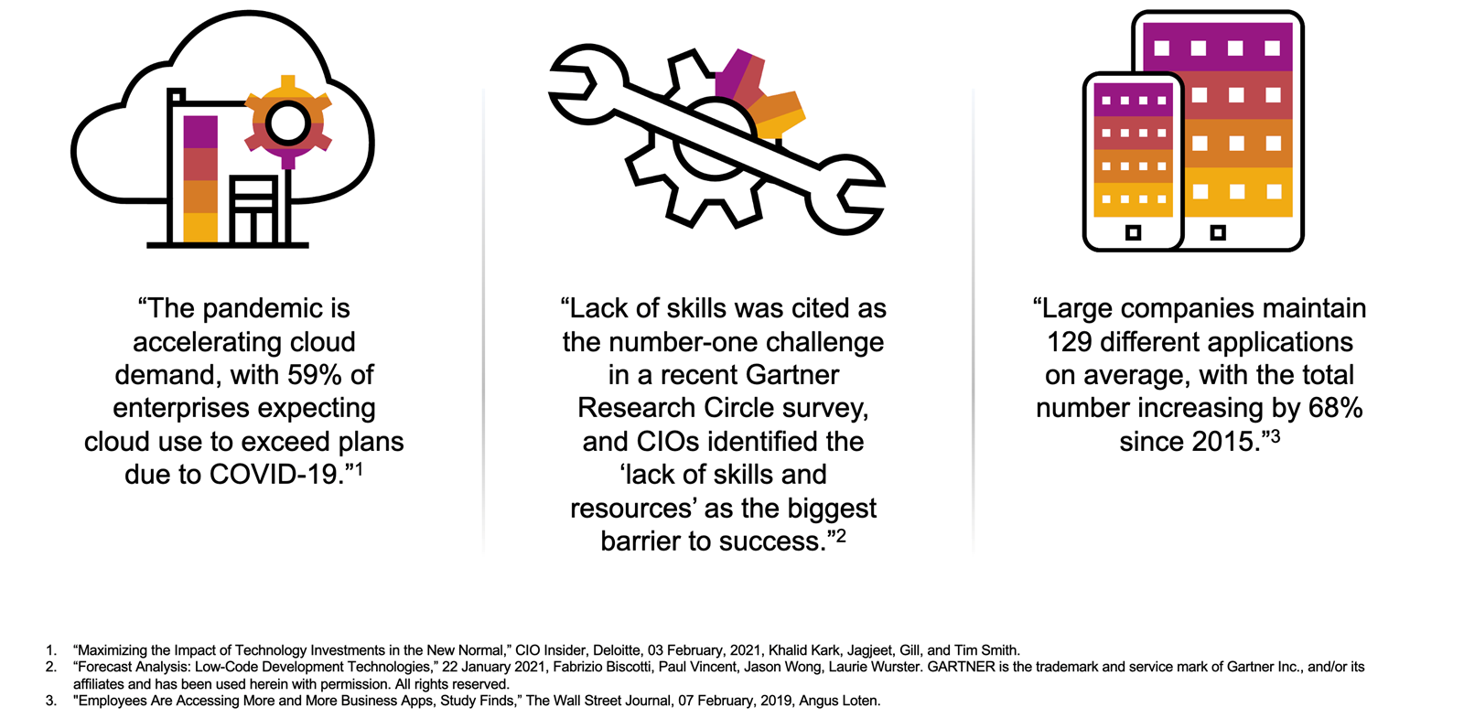
Introduction to Problem Solving With LCNC and Citizen Development
www.anubhavtrainings.com

Slide 8
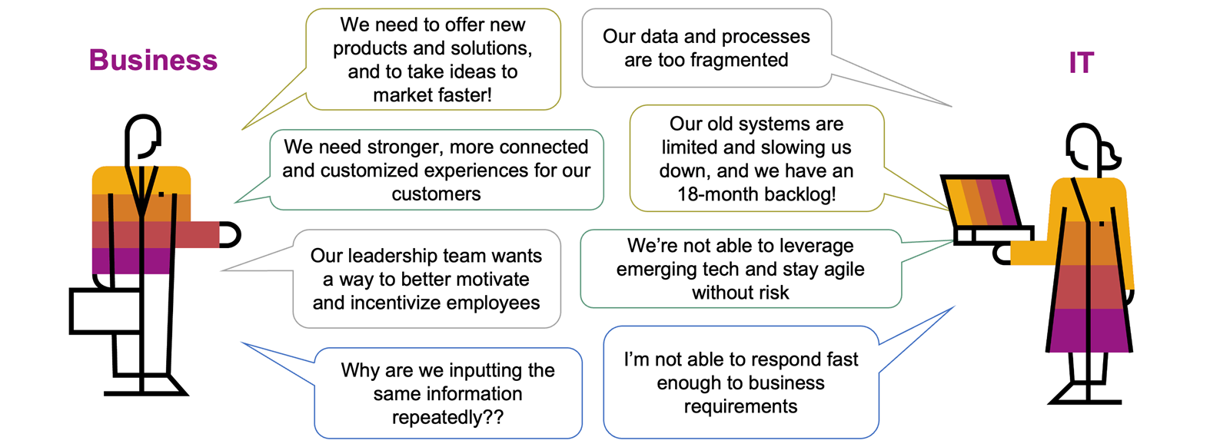
Solving Problems with LCNC and Citizen Development
www.anubhavtrainings.com

Slide 9
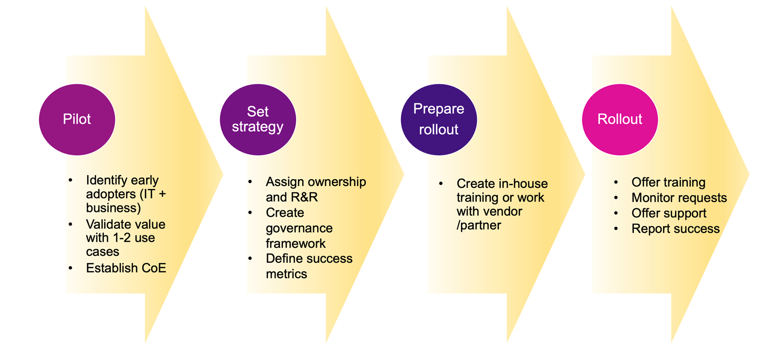
Rolling Out of Citizen Development in Your Organization
www.anubhavtrainings.com

Slide 10
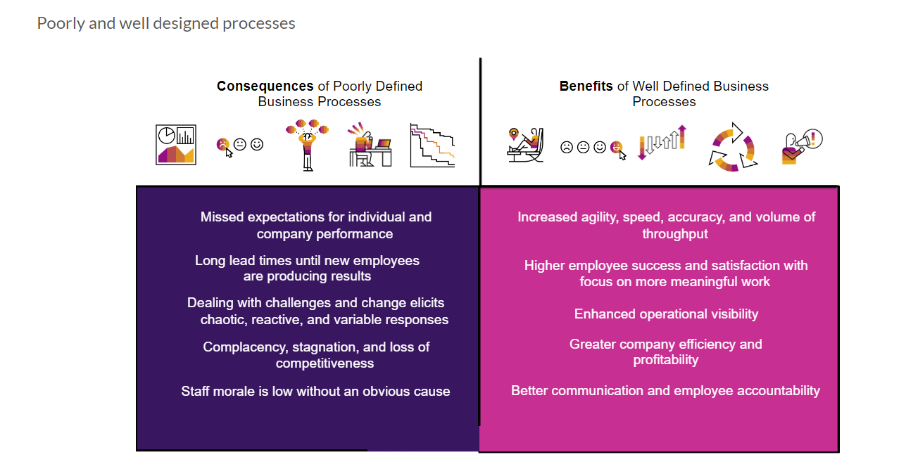
What is Business Process and BPM
In big organizations the large number of employees can only be managed when we have pre-defined, standardized processes. Processes in each area like leave request/approval, SRM purchasing, Order-to-cash, order approval, maintenance contract preparation, procure-to-pay, hiring.
Business process is the heart of an ERP system and a software which manages such business processes is called BPM.
It is in the best benefit of a company to comply to business process is to automate the same.
First, let’s clarify why businesses need Business Process Management Software (BPMS) like SAP Build Process Automation. In a company running thousands of processes, it can be challenging for management to see where things are going wrong. In the end, it all comes down to how well business processes can be defined and executed. Business Process Management Software helps you to bring structure into the large amount of your company’s business processes. It helps to prevent potential chaos and to clearly define and manage the processes. Let’s have a look at the consequences that poorly defined business processes mean for your company, and which benefits well-defined business processes offer.
www.anubhavtrainings.com

Slide 11
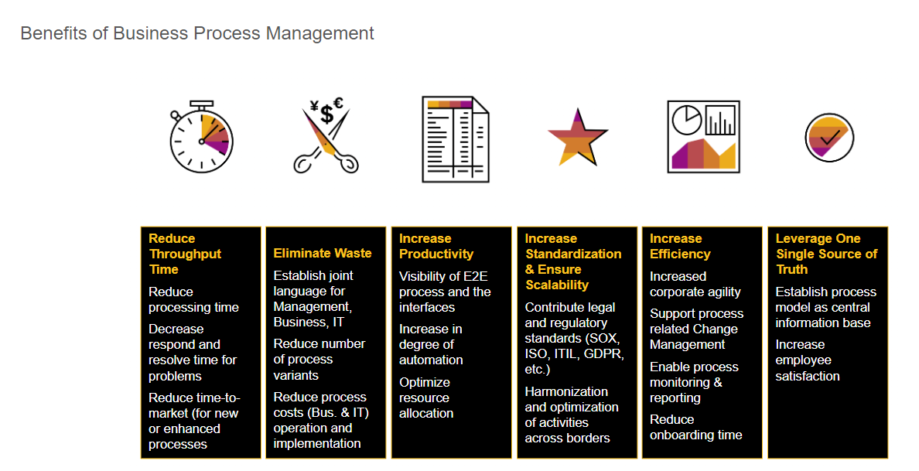
What is Business Process Management?
Business Process Management (BPM) is an approach used to identify, analyze, measure, and improve an organization’s processes. BPM is not to be seen as just another software in your company, but rather as a strive for operational excellence. It helps a company run faster, better, and at a lower expense, too.
www.anubhavtrainings.com

Slide 12
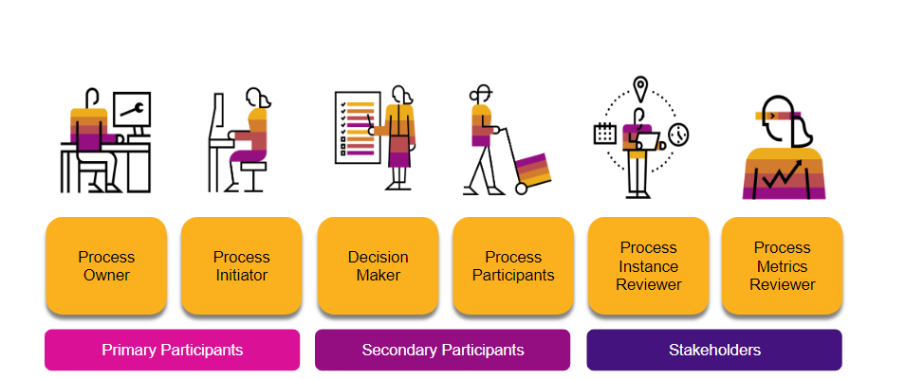
Roles Involved in Business Processes
The key roles involved in a business process can be categorized into three different groups: Primary Participants, Secondary Participants, and Stakeholders. The following example - Roles involved in a Laptop Ordering Process - provides a simple overview.
Process Owner
Is overall, responsible for a process from the business perspective. Needs to trigger process adjustments when something does not run smoothly.
Process Initiator
Starts the process by performing an action. This can happen knowingly or unknowingly.
Decision Maker
Is responsible for taking decisions that influence the direction of the process. Approvals or rejections naturally lead to different process outcomes.
Process Participants
Need to perform certain tasks within the process. These can be physical tasks or tasks performed within software systems.
Process Instance Reviewer and Process Metrics Reviewer
Has a particular interest in certain process runs or the overall process metrics due to their job description.
www.anubhavtrainings.com

Slide 13
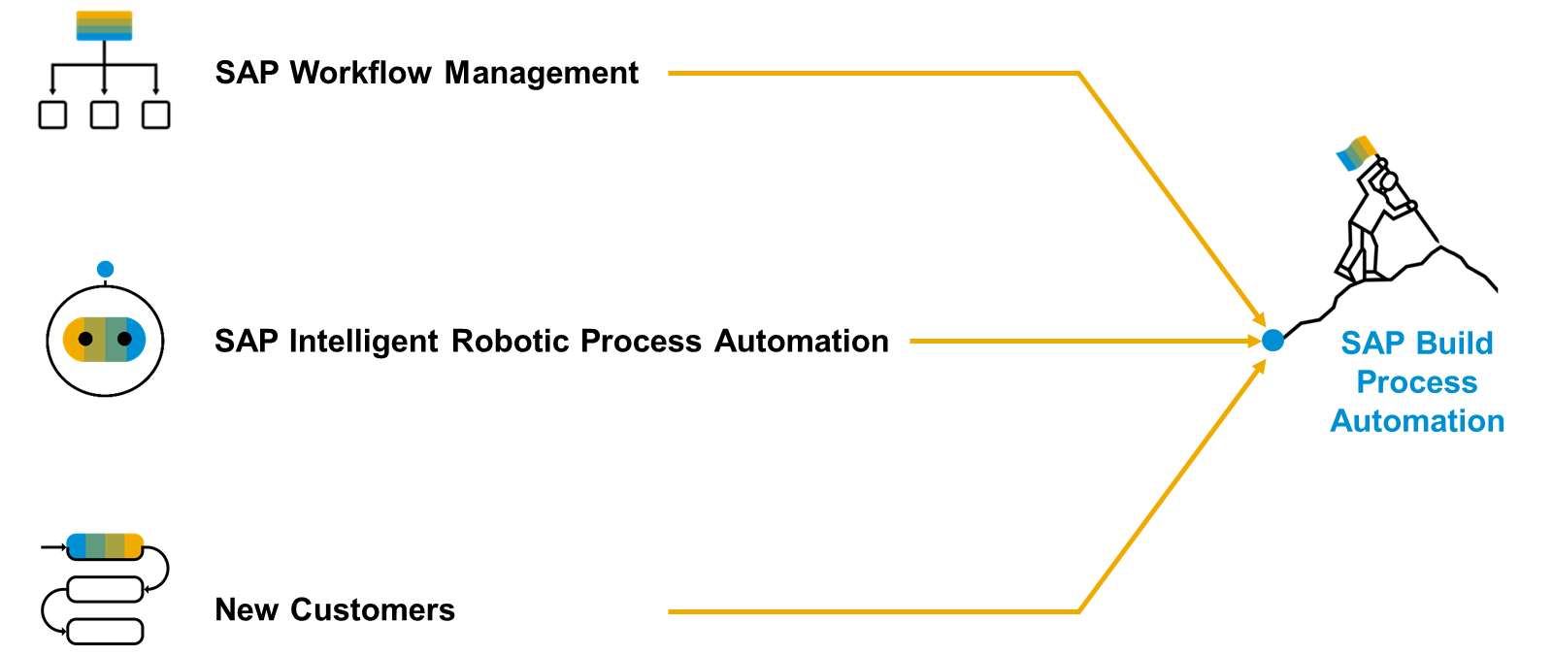
SAP Build Process Automation
www.anubhavtrainings.com
Notes:
SAP Build Process Automation is a solution that evolved out of the former stand-alone SAP products - SAP Workflow Management and SAP Intelligent Robotic Process Automation. It provides a new citizen developer experience that didn't exist in either of the two former products. As you or your company might have used SAP Workflow Management or SAP Intelligent Robotic Process Automation in the past, you are looking for a path into the joined solution. Fortunately, SAP Build Process Automation is fully compatible with all workflow and automation artifacts that you have created.

Slide 14
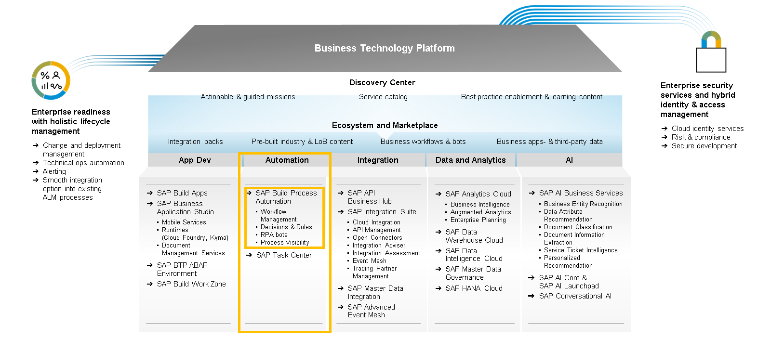
SAP Build Process Automation runs on SAP Business Technology Platform
Content
www.anubhavtrainings.com
Notes:
SAP Build Process Automation runs on SAP Business Technology Platform, so citizen developers can operate confidently with a trusted, enterprise-grade multi-cloud platform taking care of security, authorization, governance, and monitoring.
Furthermore, there’s an integration between SAP Signavio and SAP Build Process Automation that enables over 135 tailored process improvement recommendations to be automatically triggered and executed for continuous process monitoring optimization.
Finally, SAP Build Process Automation users can now automate Google Workspace applications in their processes, i.e., extract and change data from Google Sheets, retrieve dates from Google Calendar and automatically upload files to Google Drive.

Slide 15
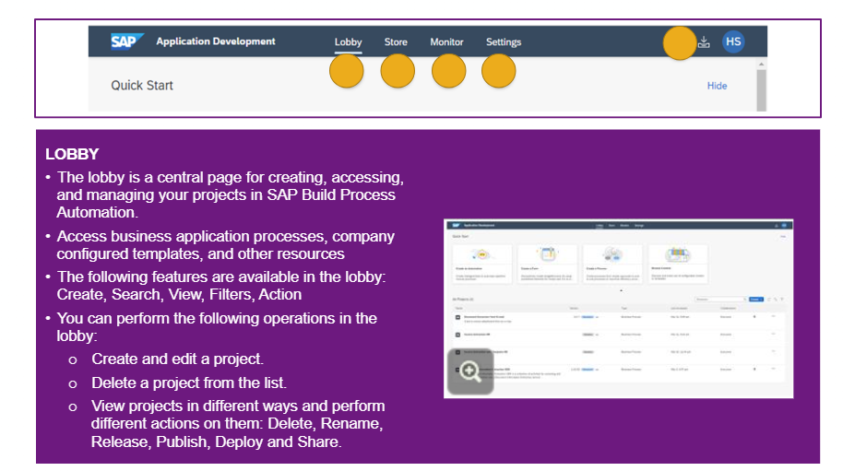
Snapshot of SAP Build Process Automation
Use the project lists view of SAP Build Process Automation in the Lobby to review existing or create new projects. Refresh, reorder, filter by type or collaborators, and complete actions such as releasing, publishing, and sharing.
From there, you can open any project and work with the capabilities, including the:
Store: with pre-built process automation content.
Monitoring: where you can look after automations and events.
Settings: where you can check the details of deployed projects and configure agents.
My Inbox: the place for you to process tasks from desktop or mobile device.
www.anubhavtrainings.com

Slide 16
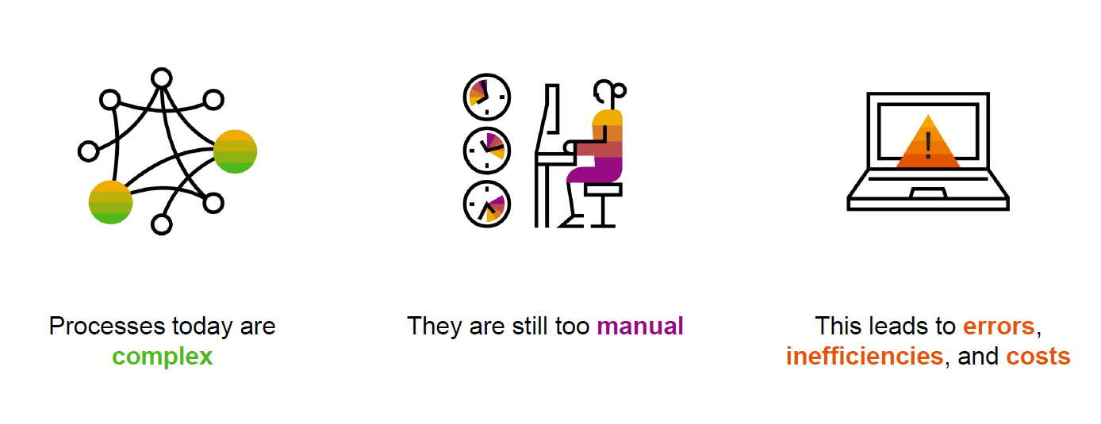
Processes run the world But…
www.anubhavtrainings.com

Slide 17
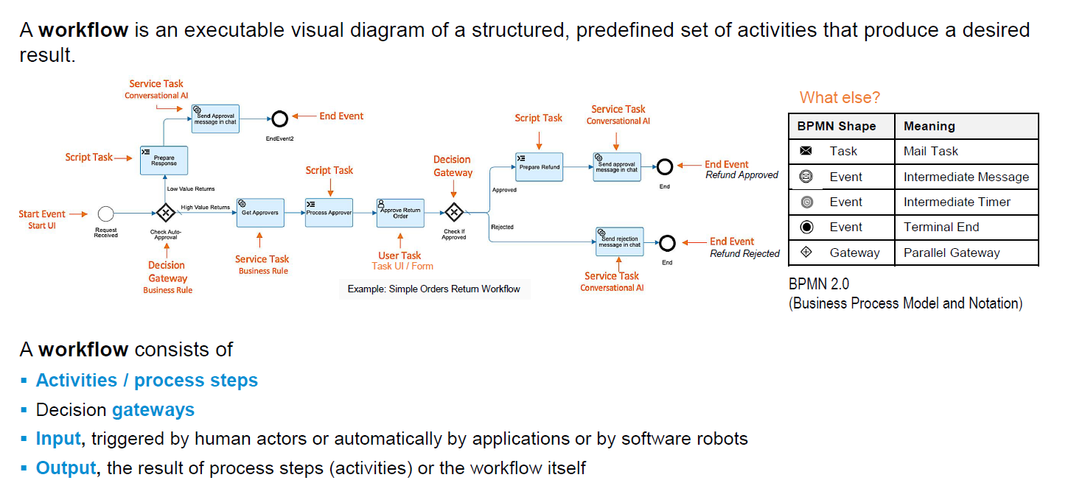
What is workflow?
Content
www.anubhavtrainings.com

Slide 18
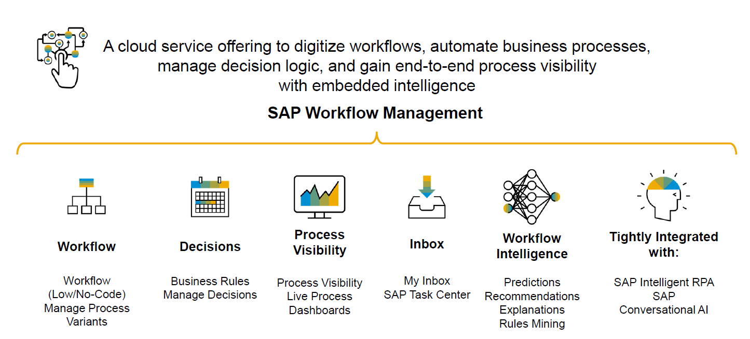
Workflow management
Content
www.anubhavtrainings.com

Slide 19
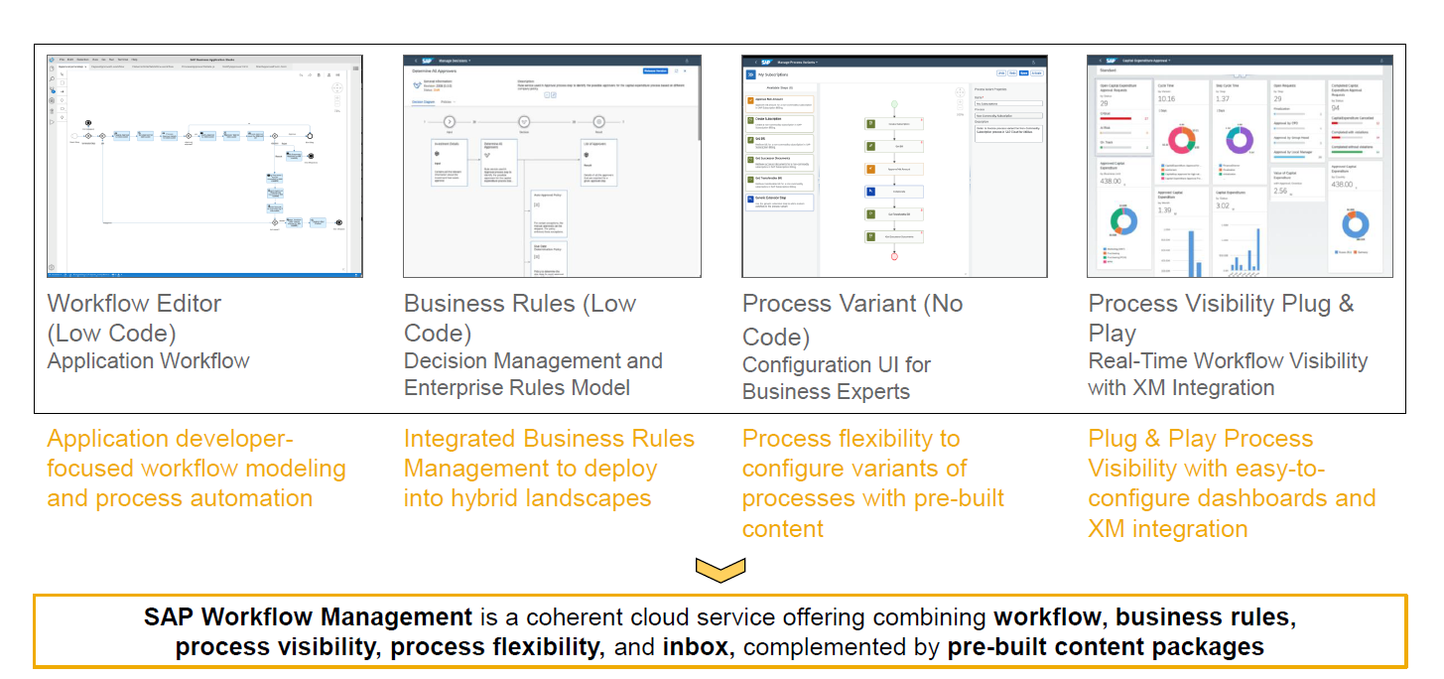
Service offerings
Content
www.anubhavtrainings.com

Slide 20
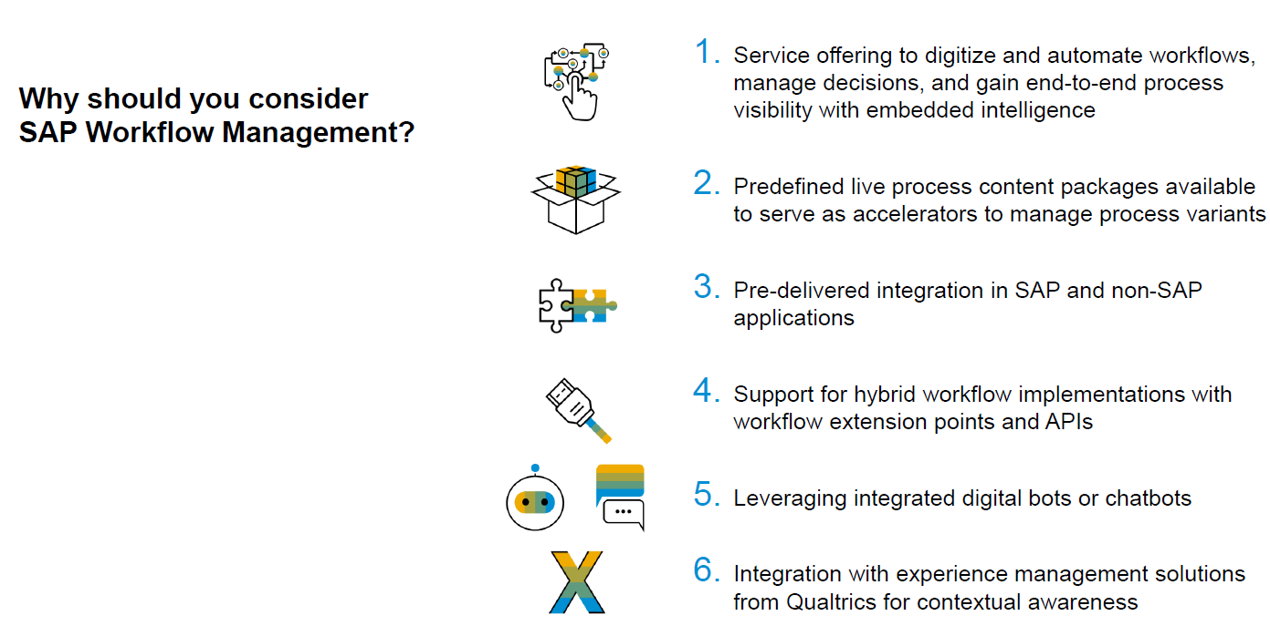
Why SAP BTP WM?
Content
www.anubhavtrainings.com

Slide 21
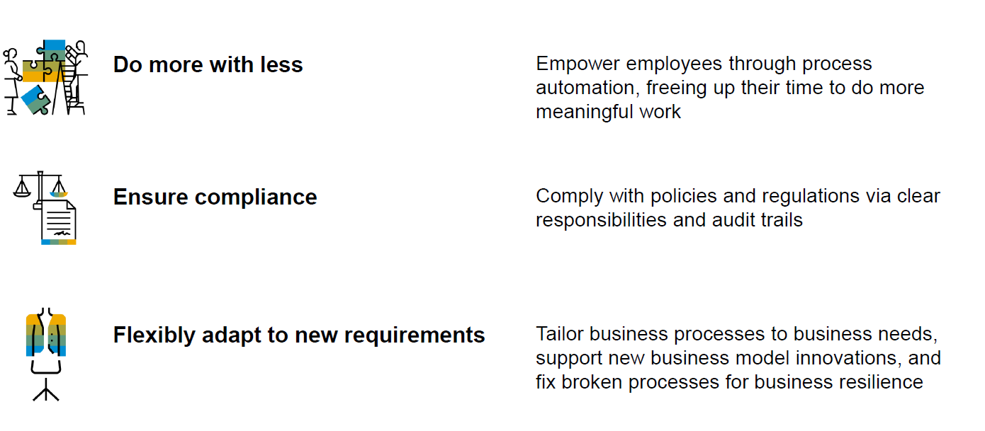
Key Benefits
Content
www.anubhavtrainings.com

Slide 22
Title
Content
www.anubhavtrainings.com

Slide 23
Title
Content
www.anubhavtrainings.com

Slide 24
Title
Content
www.anubhavtrainings.com

Slide 25
Title
Content
www.anubhavtrainings.com

Slide 26
Title
Content
www.anubhavtrainings.com

Slide 27
Title
Content
www.anubhavtrainings.com

Slide 28

What We Did
Let’s Summarize

Slide 29

www.anubhavtrainings.com
Thank You
End of Day 1

Slide 30



We’re committed to empower you to be
#FutureReady
through powerful training solutions.
We build the workforce of the future.
250+
Corporate Clients
30,000+
Learners Trained
25000+
Learners Placed
FREE WEBINARS
Sign up for free webinars with industry experts every fortnight!
Enroll Now!
Contact us today!
https://anubhavtrainings.com

